Slide 1
ROTARY PRESENTATION
APRIL 6, 2021
PRESENTER: KIMBERLY PONTIUS CEO ASPIRE NORTH REALTORS®

Slide 2
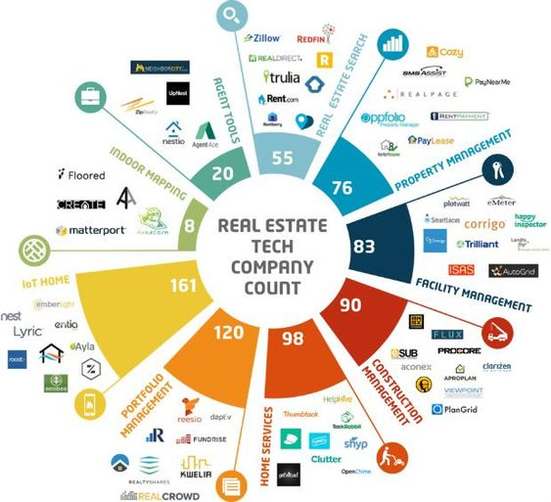
THE REAL ESTATE INDUSTRY
MORPHING FROM JUST A TRANSACTIONAL MODEL TO A TECH MODEL.
WE ARE THE EPITOME OF BIG DATA
TECH SERVICES AND DATA GATHERING, PROCESSING AND ANALYSIS ARE ALL INCREASING PRESURE ON TRADITIONAL BROKERAGES AND SALES PROFESSIONAL.
BIG MONEY HAS BEEN INFILTRATING THE FIELD AND CONTINUES TO DRIVE CHANGE AT A BREAKNECK PACE.

Slide 3
National Overview
Like the housing bubble bursting in 2008-2009 the housing shortage is now everywhere and we were informed well in advance that this would happen.
“But a deeper and longer-term issue to watch out for is the increasing possibility of a housing shortage across many parts of the country.”
SEEDS OF A HOUSING SHORTAGE – REALTOR MAGAZINE
NOVEMBER 2, 2012
Dr. Lawrence Yun - NAR Chief Economist
https://magazine.realtor/news-and-commentary/economy/article/2012/11/seeds-housing-shortage

Slide 4
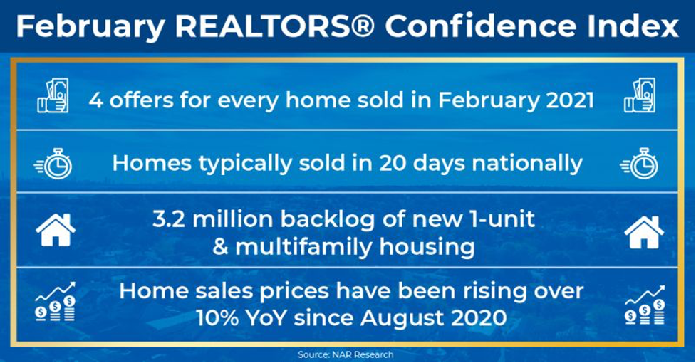
Buyer competition Intensifies
Nearly Four Offers Received Per Sold
REALTORS® reported 74% of existing homes sold in February 2021 were on the market for less than 30 days. In May 2015 this median was 90 days.
Y-O-Y Percent Change in the Median Existing-Home Price: U.S 15.8%, Northeast and West 20.6%, Midwest 14.2% and South 13.6%

Slide 5
2021 starts off with a bang but IS IT sustainable?
As of January the combined inventory of existing homes and new homes for sale was just at 1.7 months.
A balanced housing market needs to reflect a 6 months supply to keep up with monthly pace of demand.
It is estimated that we need 2.7 million more homes for sale on the market to meet demand.
Nationally commercial is rebounding but mostly in the industrial sector. Office space will continue to lag behind until late 2021 / mid-2022. SIOR

Slide 6
Farmland – realtor magazine /WSJ April 5, 2021
Farmland values increased during 2020 as higher grain prices buoyed revenue for farmers. Land prices in the region that covers parts of Illinois, Indiana, Iowa, Michigan, and Wisconsin saw a 6% increase last year, which marks the largest hike since 2012, according to the Federal Reserve Banks.
Farmers eager to cash in are selling parcels of land, leading to an investor shopping spree. Large farmers dominate among owners of the nation’s 900 million acres of farmland. Seventy-five percent of cropland in the U.S. is controlled by about 13% of the nation’s farmers. Smaller farmers are finding it more difficult to afford a down payment on land parcels or compete for land leases, the Journal reports.
Indeed, competition is fierce as supply for farmland remains low. U.S. farmland has decreased by 25%—or 305 million acres—since 1950, according to USDA data. Investors are scooping up farmland: Pension and hedge fund companies view it as a lucrative alternative to stocks and bonds.

Slide 7
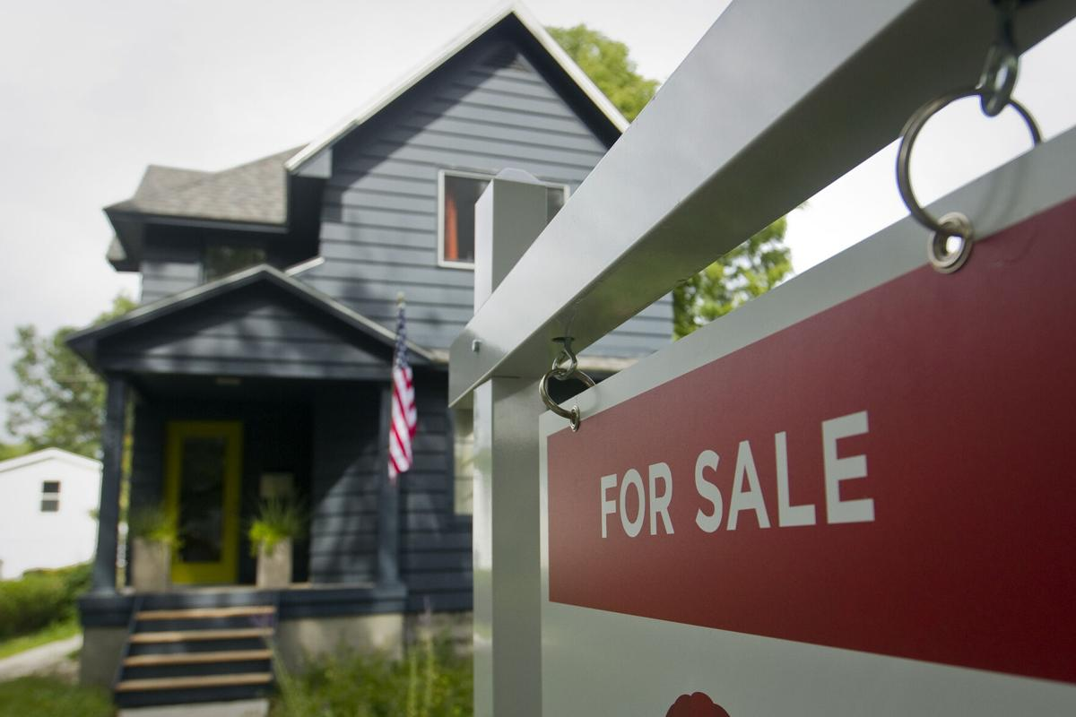
CURRENT REGIONAL MARKET
Photo Courtesy Record-Eagle

Slide 8
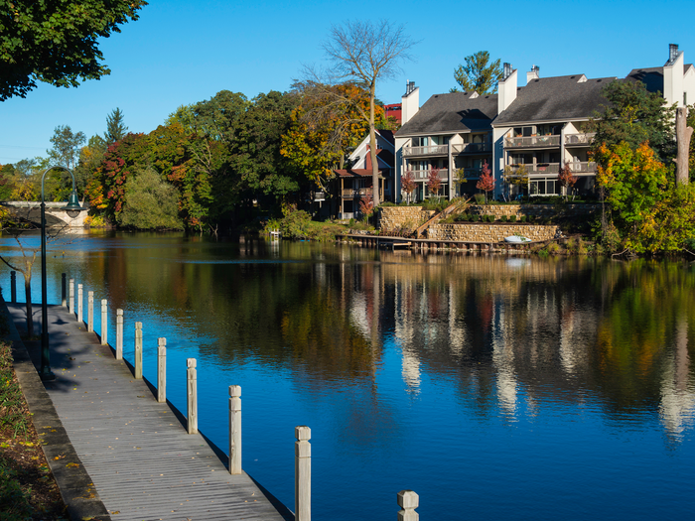
LOCAL MARKET RECOVERY BEGAN IN LATE 2010, HIT BUBBLE PARITY IN 2014, SURPASSED TOP MARKET IN 2017 WITH Y-O-Y RECORDS TO DATE.

Slide 9
Key statistics
MARCH 2021 / 2020
AVERAGE HOME PRICE - $386,193 / $288,902
MEDIAN HOME PRICE -$256,500 / $235,000
DAYS ON MARKET – 92 / 120
UNITS SOLD – 240 / 217
CURRENT INVENTORY – AS OF APRIL 5TH FOR THE ENTIRE MLS - 4339 LISTINGS
  RESIDENTIAL
  COMMERCIAL
  VACANT LAND
The Five County Region ONLY
GRAND TRAVERSE
LEELANAU
BENZIE
KALKASKA
ANTRIM
AS PUBLISHED BY NORTHERN GREAT LAKES REALTORS MLS

Slide 10
CHALLENGES
COST OF DIRT
COST OF MATERIALS
COST OF LABOR
TAX RATES
LABOR SHORTAGES IN SKILLED TRADES AND UNSKILLED WORKERS
LOCAL ORDINANCES / RED TAPE
CAPITAL
CAPACITY OF SUPPORT SERVICES / INFRASTUCTURE
NIMBY / BANANA

Slide 11
Solutions?
TIME TO PULL OUT ALL THE STOPS
START WITH HOUSING NORTH – HOMES FOR OUR FUTURE PROGRAM
LOOK AT ALL LEVELS OF FUNDING AND INVESTMENT
WORK WITH LOCAL UNITS OF GOVERNMENT
PUT MONEY, DEVELOPERS, COMMUNITY LEADERS ALL IN THE SAME ROOM
TARGET “FAST-TRACK” PROJECTS
”ONE OF THE THINGS WE LEARNED EARLY ON IN CHARITABLE GIVING IS THAT YOU CAN’T PUT KOOL-AID IN THE OCEAN AND EXPECT IT TO CHANGE COLOR.”
DAN GILBERT MARCH 28, 2021

Slide 12
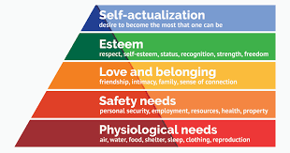
MASLOWES HIERARCHY OF NEEDS
THERE IS NOT A LEVEL OF THIS SCALE THAT HOUSING DOES NOT FULFILL A PLACE WITHIN.
WE NEED A NEW SCALE ONE THAT IS BASED ON DIFFERENT STRATA THAN CURRENT LABELS.
TIME TO THINK IN TERMS OF RESILIENT COMMUNITY HOUSING (RCH)

Slide 13
SUSTAINABILITY
WHAT GOOD IS THE USE OF A HOUSE IF YOU HAVEN’T GOT A TOLERABLE PLANET TO PUT IT ON. HENRY DAVID THOREAU

Slide 14
FINTECH
Financial technology (Fintech) is used to describe new tech that seeks to improve and automate the delivery and use of financial services.
When fintech emerged in the 21st Century, the term was initially applied to the technology employed at the back-end systems of established financial institutions. ​Since then, however, there has been a shift to more consumer-oriented services and therefore a more consumer-oriented definition. Fintech now includes different sectors and industries such as education, retail banking, fundraising and nonprofit, and investment management to name a few.
INVESTOPEDIA

Slide 15
Thank you & Questions
KIMBERLY R. PONTIUS
CEO
ASPIRE NORTH REALTORS ® and NORTHERN GREAT LAKES REALTORS MLS™
KIM@ASPIRENORTHREALTORS.COM

