Slide 1
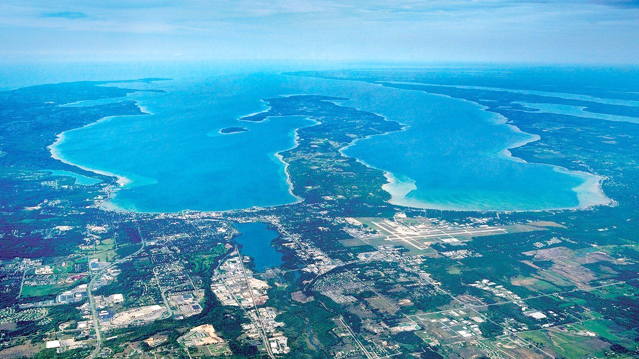
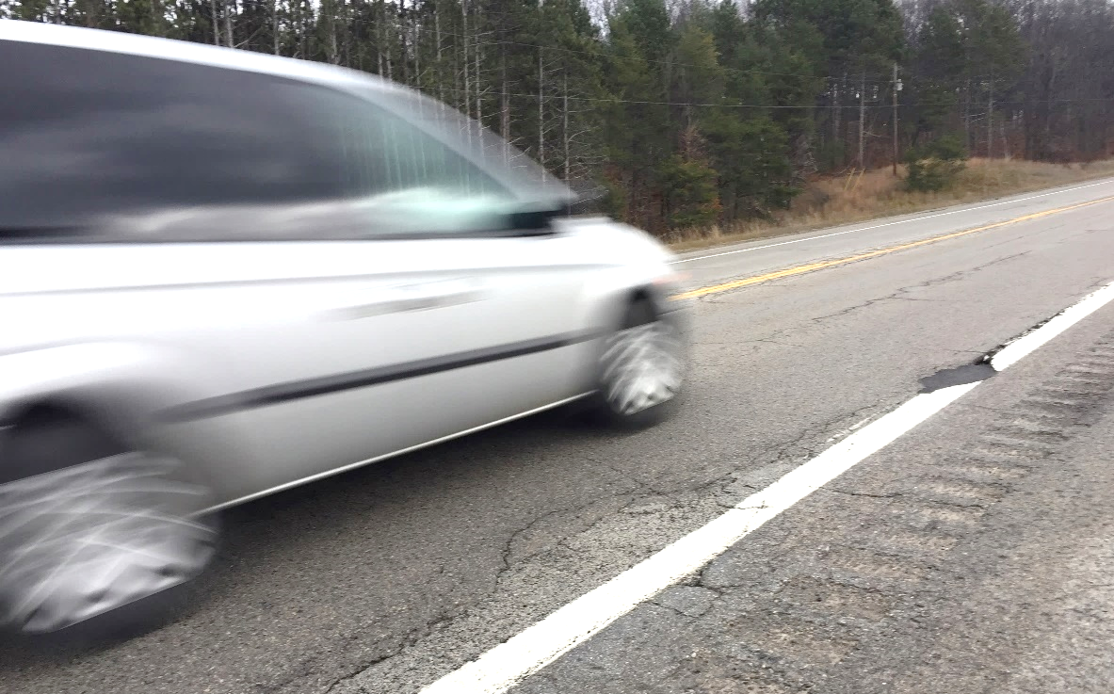


US-31 and M-72 Are The Two General Routes That Connect Traverse City To The Major Population Centers Downstate
Busy Commuter Routes
Over 3.5 Million Visitors To Grand Traverse Area Per Year
Notes:
Tuesday, May 15, 2018
Traverse City Rotary Club
Great Wolf Lodge
11:45 a.m. -1:15 p.m.
12:40 p.m. Speak for 15-20 min + Q&A w/ Rick Liptak
Requested info on:
An East/West Corridor
Key interchanges of M72/22 both east and west of town
Pedestrian crossings on M22 (Southern Leelanau Co, Acme, Grandview Parkway)
Highly variable traffic flow
3.5 million visitors, 100,000 residents
Commuter routes

Slide 2
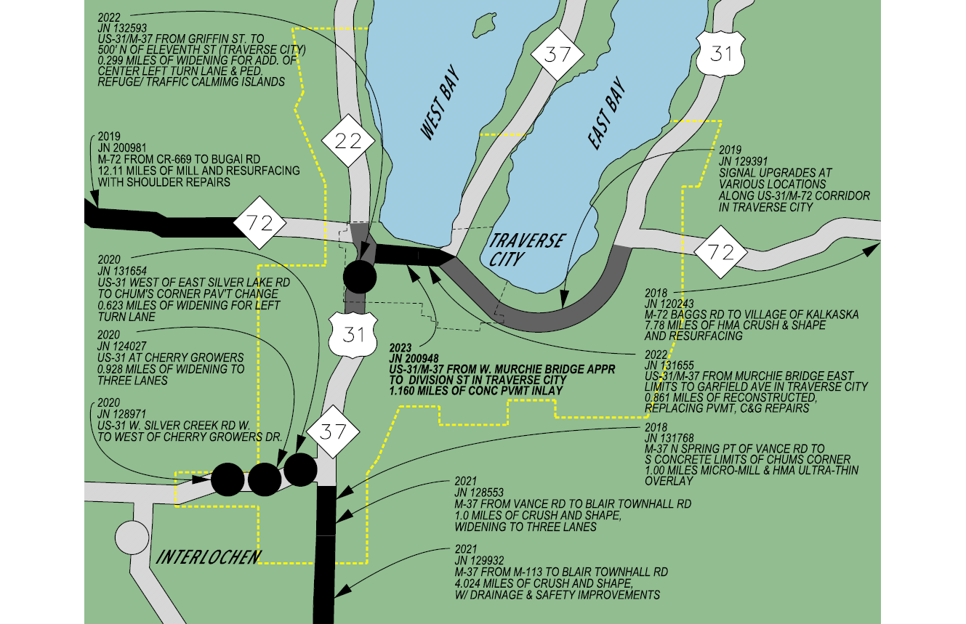
2018 - 2023
*PROPOSED*
1.95

Slide 3
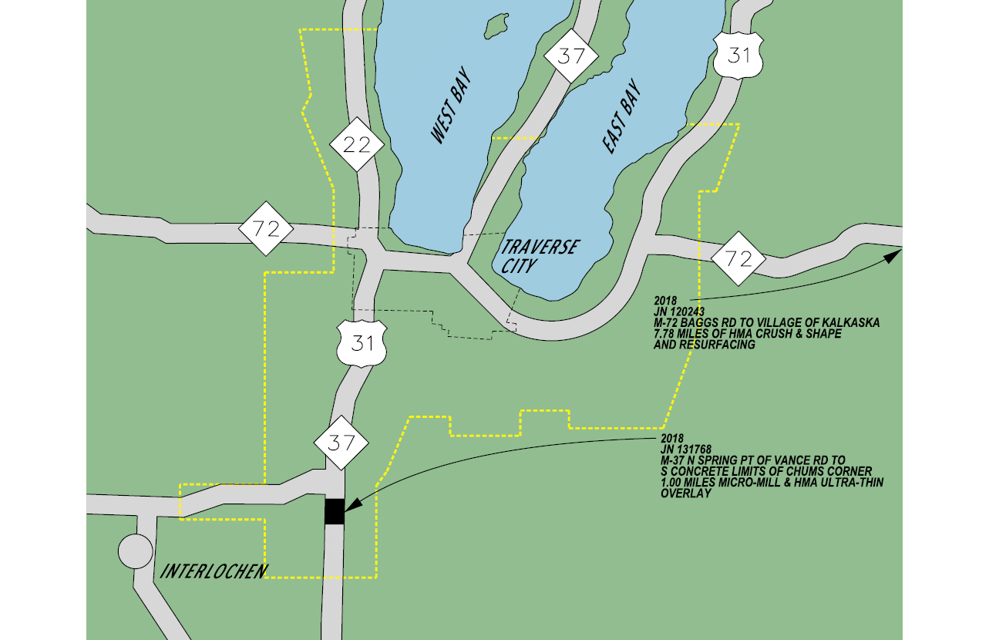
2018
1.95

Slide 4
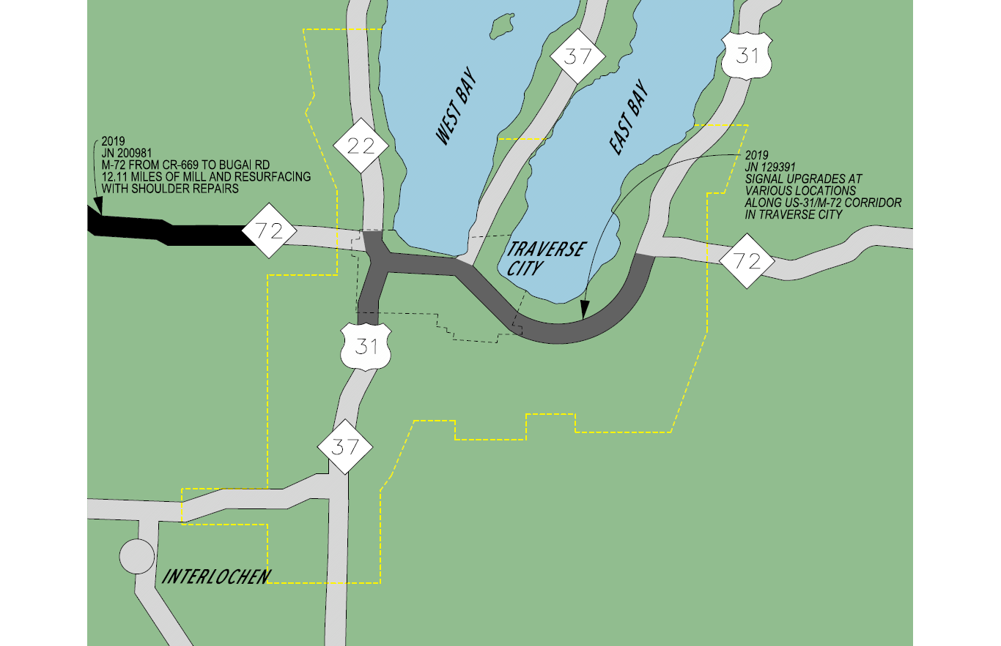
2019

Slide 5
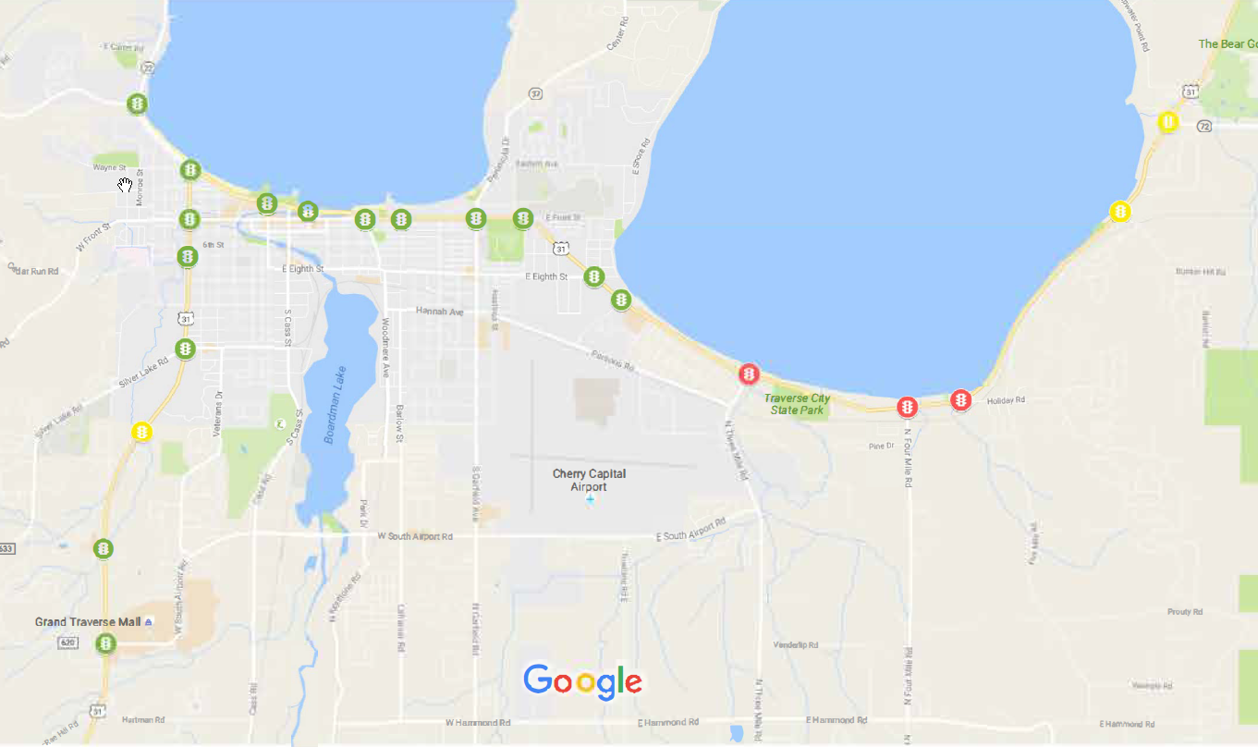
Signal Upgrades
Base Plans Complete
Planned for 2019 & 2020 construction
21 Traffic Signal Locations
$2.9 Million Construction Cost
Interconnection with County and City Signals

Slide 6
Traffic Signal Operations
Traditional traffic signal timing
Collect Traffic Counts
Develop Timing Plans
Manually observe and adjust
Every 5-10 Years
AM, PM and Off-Peak
Summer and Non-summer
Separate plan for AM, PM
And Off-Peak
Separate plans for summer
And non-summer

Slide 7
Adaptive Signal Control Technology (ASCT)
ASCT Definition: A traffic management strategy in which traffic signal timing changes, or adapts, based on actual traffic demand.
ASCT is ideal for corridors with significant fluctuations in traffic volumes and patterns

Slide 8
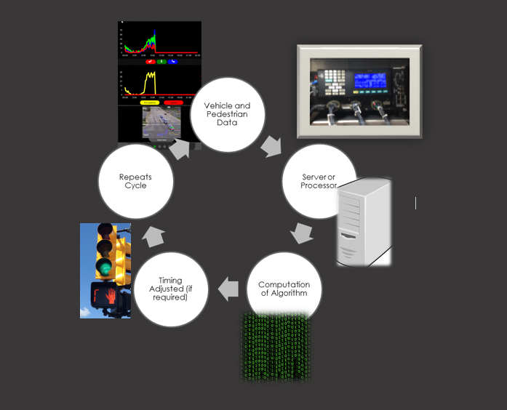

Adaptive Signal Control Technology (ASCT)

Slide 9
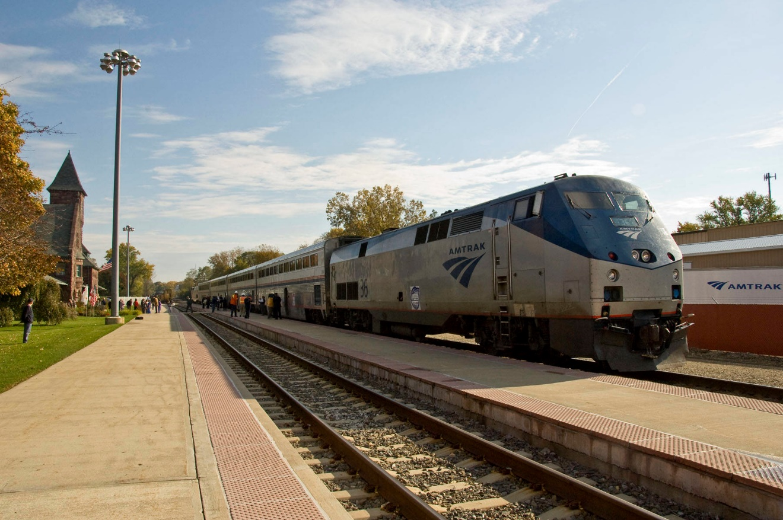

Slide 10
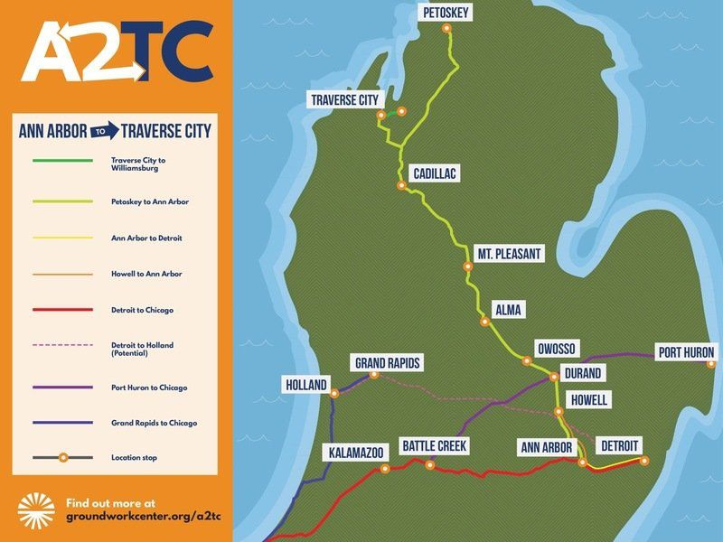

Slide 11
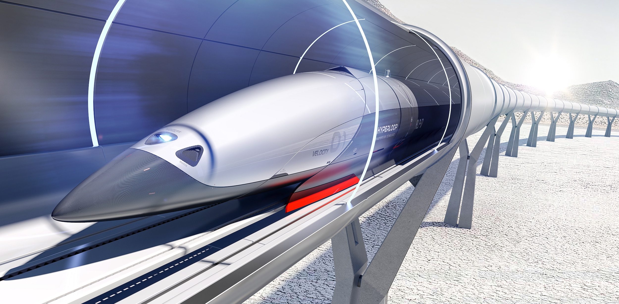

Slide 12
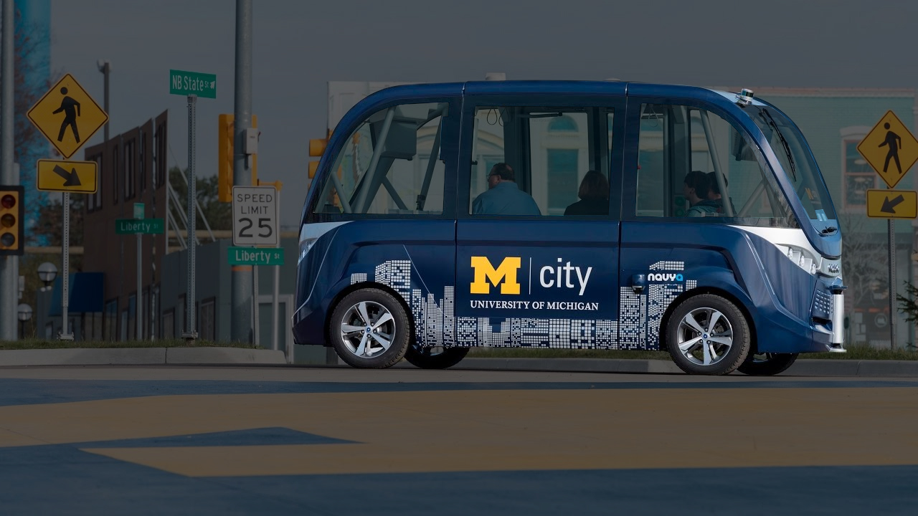



Slide 13
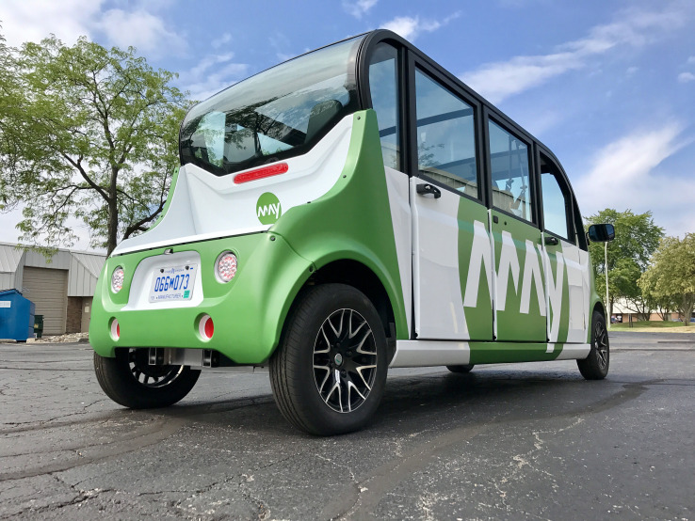


Slide 14
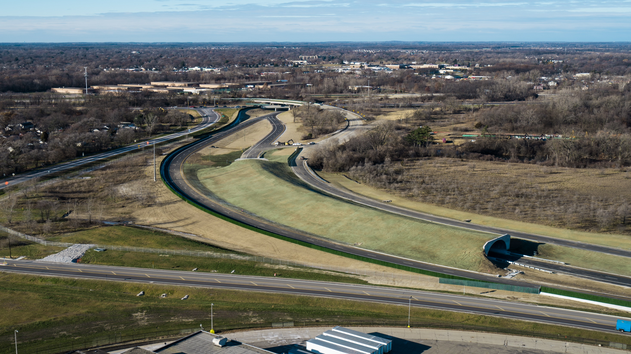

















Slide 15
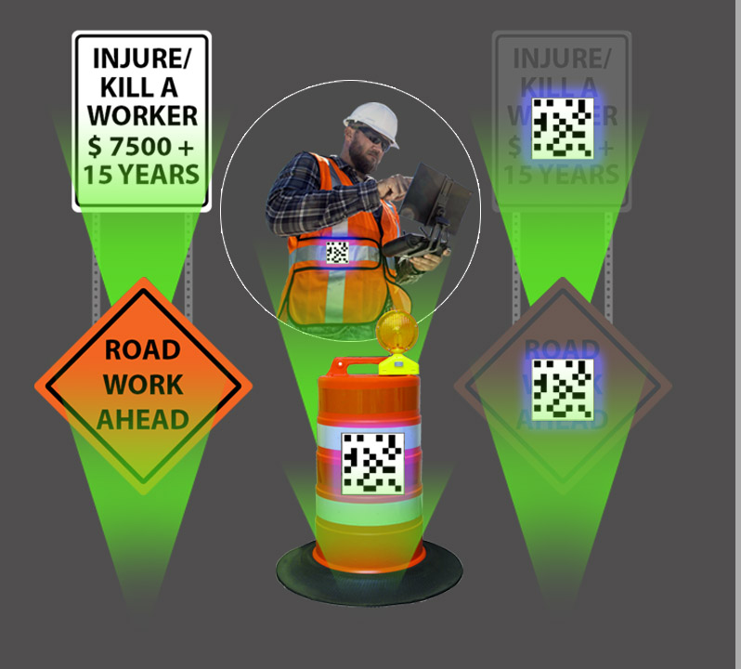
YOUR
CONNECTED
WORK ZONE

Slide 16
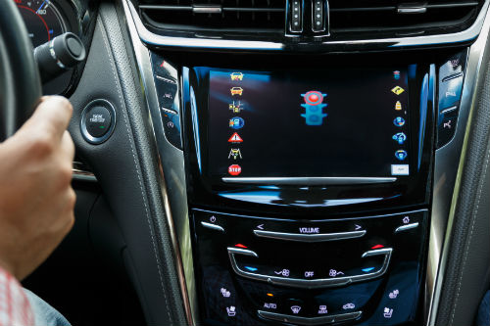
MDOT ITS SIGNALS CV INITIATIVE
CV Enabled Signals Policy
Signal Controller Spec Update
All new or upgraded traffic signals on the MDOT system will be CV-enabled going forward

Slide 17
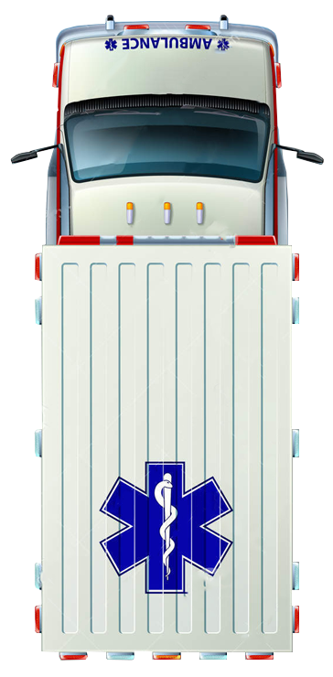
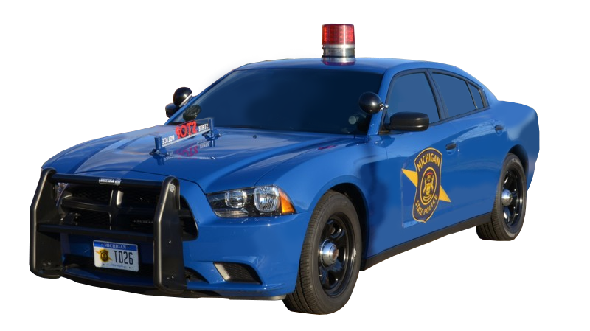
CAV + FIRST RESPONDERS
Location Information
Damage/Injury Information
Signal Priority & Preemption
Vehicle Detection/Collision Avoidance
Road Weather Information
Vehicle Shutdown

